Slide 1

Gesture-Voice Hybrid Interface
Guided By
Prof.S.G.Kamble
Group No.10
Sagar Sadake B400070550
Sangram Wabale B400070562
Mohit Chinni B400070527 Kanchi Sonkule B400070559

Slide 2
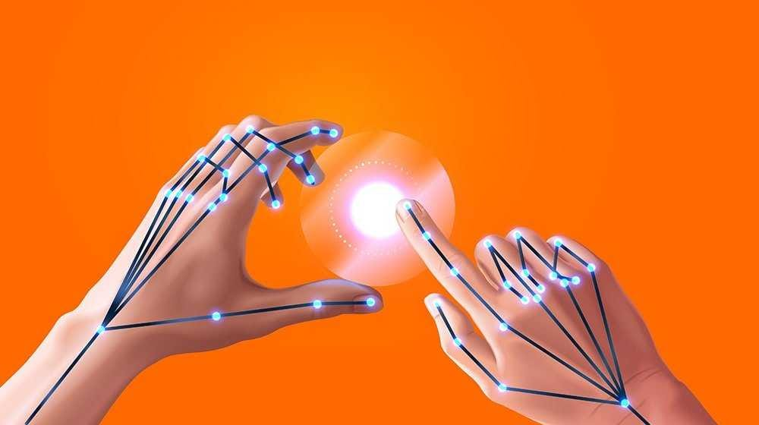
CONTENTS
Problem Statement
Introduction
Motivation
Project Scope
Literature Survey
Methodology
Hardware and Software Requirement
Technical Details
Implementation Details
Project Plan
Advantages
Conclusion
Future Scope
References

Slide 3
Problem Statement
Design a "Gesture Voice Hybrid Interface" that replaces traditional mouse and keyboard inputs with hand gestures and voice commands, enabling device-free control of a computer using only a webcam. The system should utilize OpenCV, MediaPipe, and Python to interpret gestures for mouse functions (clicking, dragging, scrolling) and voice commands for keyboard inputs, offering an intuitive, hands-free human-computer interaction experience.

Slide 4
Introduction
The ”Gesture Voice Hybrid Interface” project aims to replace traditional input devices, such as the mouse and keyboard, with a more intuitive and natural system that uses hand gestures and voice commands.
By utilizing a webcam and advanced technologies like OpenCV and MediaPipe, the system enables real-time gesture recognition for actions like cursor movement, clicking, and scrolling, while voice commands handle additional operations.
This hybrid approach not only enhances the user experience but also improves accessibility for individuals with disabilities and allows for touchless interaction, making it ideal for hygiene-sensitive environments.
Ultimately, the project seeks to simplify computer operations, boosting productivity and efficiency through a seamless, hands-free interface

Slide 5
Motivation
The motivation behind the ”Gesture Voice Hybrid Interface” project stems from the growing need for more intuitive, inclusive, and hygienic methods of interacting with technology.
Traditional input devices like keyboards and mice can be cumbersome, limiting in terms of accessibility, and often depend on physical contact, which may not be ideal in hygiene-sensitive environments.
With the rise of touchless technologies and the increasing importance of accessibility in digital spaces, there is a clear demand for a more natural, hands-free way to interact with computers.
The motivation is to enhance the user experience, improve accessibility, and create a more efficient and streamlined way to interact with computers, ultimately driving innovation in human-computer interaction.

Slide 6
Project Scope
The scope of the "Gesture Voice Hybrid Interface" project includes:
Development of Gesture Recognition System:Use computer vision techniques to detect and interpret hand gestures in real-time using a webcam.
Integration of Voice Command System:Implement speech recognition to execute commands based on voice inputs for a hands-free user experience.
Seamless Hybrid Interaction:Combine gesture and voice inputs for efficient and versatile control of computer functions.
Cross-Platform Compatibility:Design the system to work across multiple operating systems (e.g., Windows, Linux, macOS) and applications.
User Interface Design:Create an intuitive, user-friendly interface that integrates with various software applications.

Slide 7
Project Scope
Accessibility Features : Ensure that the system provides accessible input options for individuals with physical disabilities.
Testing and Validation : Conduct performance testing to ensure accuracy, responsiveness, and reliability of the gesture and voice recognition systems.
Potential for Future Enhancements : Allow for future development of more complex gestures, multi-language support, and integration with AI for intelligent contextual responses.

Slide 8
Performance Evaluation
Latency
Average delay: 200ms from gesture/voice input to action execution.
Sufficient for real-time interaction.
Resource Usage
CPU Usage: ~40%
RAM Consumption: ~1.2GB
Tested On: Intel i5 Processor, 8GB RAM
Efficient for mid-range systems.
Limitations
Gesture Accuracy drops by ~20% in poor lighting conditions.
Voice Recognition is affected by background noise (ambient sounds, fan noise, etc.).

Slide 9
Literature Survey
Sr.No. | Reference Paper | Key Points | Challenges
1. | S. Patil, S. Kanganolli, J. Deore, and K. Vartak, "Review on Touchless Virtual Mouse Technologies and A.I. Voice Assistants," International Journal of Progressive Research in Engineering and Management Science (IJPREMS), vol. 3, no. 3, pp. 160-167, 2023. DOI: https://doi.org/10.58257/IJPREMS33160. | The paper explores innovations in Human-Computer Interaction (HCI), specifically on two fronts: virtual mouse systems and AI-driven voice assistants. The highlight is the Mouse less system, which utilizes infrared cameras and lasers to interpret hand gestures, allowing for mouse control without physical devices. | The reliance on real-time camera technology for touchless interactions may require precise calibration, which can be difficult across different devices and environments. Both virtual mouse systems and voice assistants may encounter delays in real-time processing, affecting user experience in fast-paced environments.
2. | M. Nazeer, S. A. G, A. Priyadarshini, C. C. B. Krishna, A. Anusha and A. Amreen, "Gesture Controlled Virtual Mouse and Keyboard Using OpenCV" 2023, International Conference on Emerging Techniques in Computational Intelligence (ICETCI), Hyderabad, India, 2023 | The research focuses on developing a gesture-controlled interface that leverages hand gestures, voice commands, and eye movements to interact with computers, reducing the need for physical contact. The proposed system integrates a hybrid model for gesture control that combines voice, hand gestures, and eye movements to manage computer operations virtually. A Convolutional Neural Network (CNN) is implemented using MediaPipe on top of Pybind11 to analyze inputs from hand and eye movements. | Ensuring accurate interpretation of hand gestures and eye movements through a webcam may face challenges, especially in variable lighting conditions and diverse environments. Since a webcam is the only required hardware, its limitations in resolution and response time may impact the accuracy and performance of gesture and eye movement recognition. Managing real-time recognition of multiple gestures and voice commands simultaneously, while ensuring low latency, can be complex and resource-intensive.

Slide 10
Literature Survey
Sr.No. | Reference Name | Key Points | Challenges
3. | M. Raja., P. Nagaraj, P. Sathwik, K. M. A. Khan, N. M. Kumar and U. S. Prasad, "Voice Assistant and Gesture Controlled Virtual Mouse using Deep Learning Technique," 2023 International Conference on Sustainable Computing and Data Communication Systems (ICSCDS), Erode, India, 2023, pp. 156-161, doi: 10.1109/ICSCDS56580.2023.10104619. | The study integrates voice instructions with both static and dynamic hand gestures to manage input and output processes digitally, removing the need for hardware-based interactions. The study utilizes CNN-like models and employs MediaPipe—a framework built on pybind11—to process and interpret hand gestures. | The lack of specialized hardware (e.g., sensors) could limit the system’s accuracy and performance, making it highly reliant on the quality of software algorithms and the webcam. Achieving real-time recognition of gestures and voice commands while maintaining low latency is a technical challenge, especially when using machine learning models that demand processing power.
4. | S. Srivastava, R. Tiwari, A. Garg, Rishu and R. Tiwari, "Design and Development of Gesture Recognition Based Virtual Mouse System," 2023 International Conference on Computational Intelligence, Communication Technology and Networking (CICTN), Ghaziabad, India, 2023, pp. 835-839, doi: 10.1109/CICTN57981.2023.10140390 | The study introduces an artificial intelligence-based virtual mouse system that allows for device-free computer control by utilizing computer vision and machine learning technologies The study highlights the system's potential role in preventing the spread of COVID-19 by reducing physical contact with external devices in public spaces, such as airports. The system is particularly useful in environments where minimizing contact with external devices is important, such as in medical facilities or public spaces. | The accuracy of hand gesture recognition can be challenging, especially in different lighting conditions, varying hand positions, or when users have different hand sizes. Adapting the system to different public and medical environments may present challenges, particularly if existing hardware is not optimized for computer vision tasks.

Slide 11
Objectives
The objectives of the "Gesture Voice Hybrid Interface" project are:
Replace Traditional Inputs: Develop a system that replaces the mouse and keyboard with hand gestures and voice commands for computer operation.
Increase Accessibility: Create an accessible interface for individuals with physical disabilities or those unable to use traditional input methods.
Enable Touchless Control: Implement touchless interaction for users, enhancing usability in environments where non-contact is necessary.
Boost Productivity: Simplify computing tasks to increase efficiency and reduce the reliance on physical input devices.
Develop a Scalable System: Build a system that can be expanded for future enhancements, including AI integration and advanced gesture recognition.

Slide 12
Methodology
Input Captures
Input can be through camera or webcam
Preprocessing
Frame Extraction
Noise Reduction
OpenCV
Is used for
Gesture Recognition
pyttsx3==2.98
SpeechRecognition==3.10.4
pynput==1.7.7
pyautogui==0.9.54
wikipedia==1.4.0
opencvpython==4.5.3.56
mediapipe==0.10.11
comtypes==1.1.11
pycaw==20240210
screen-brightness-control==0.24.0
eel==0.14.0
Anaconda==1.12.3
Gesture Recognition using Mediapipe
Mapping To Commands
Gesture-Action Mapping using python libraries
Commands Execution
Uses Pynput,PyAutoGUI,

Slide 13
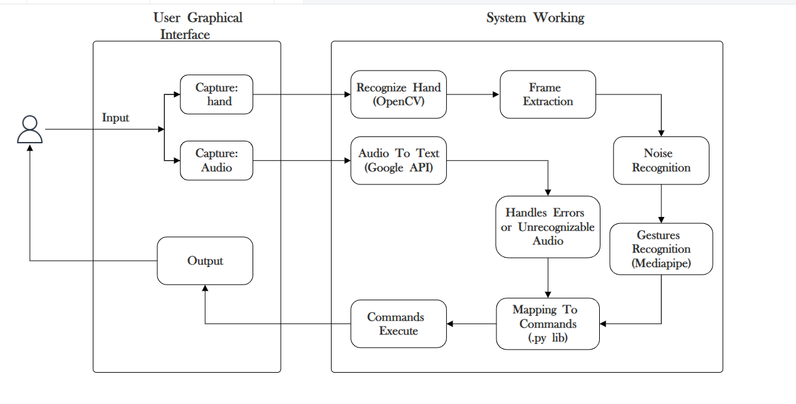
System Architecture Diagram

Slide 14
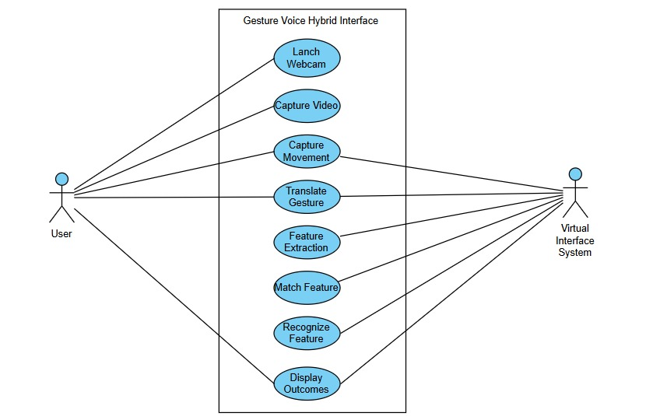
Use Case Diagram

Slide 15
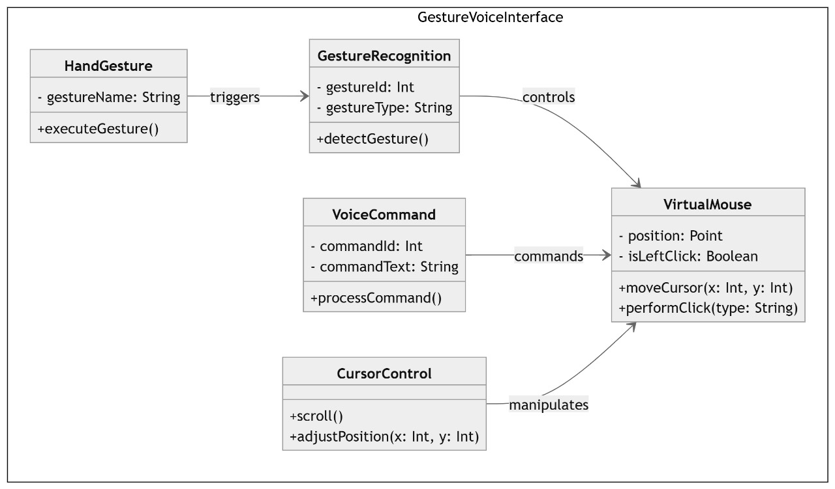
Class Diagram

Slide 16
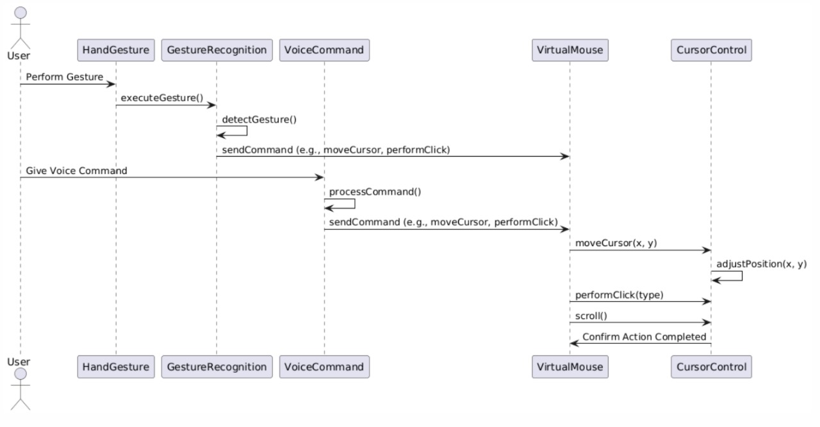
Sequence Diagram

Slide 17
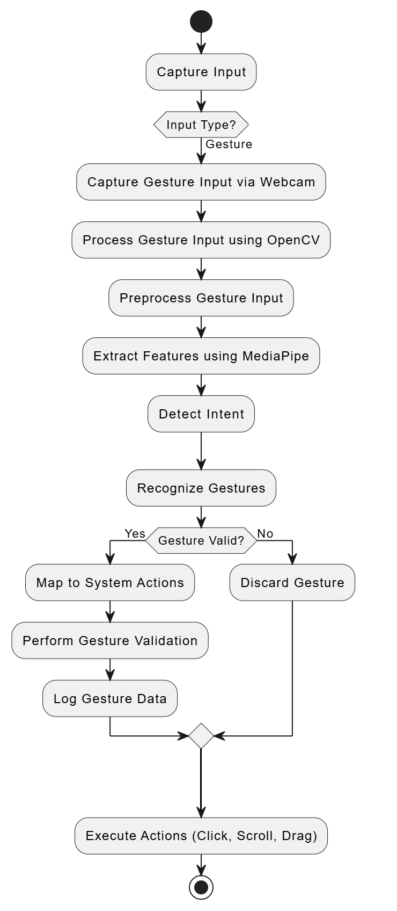
Activity Diagram

Slide 18
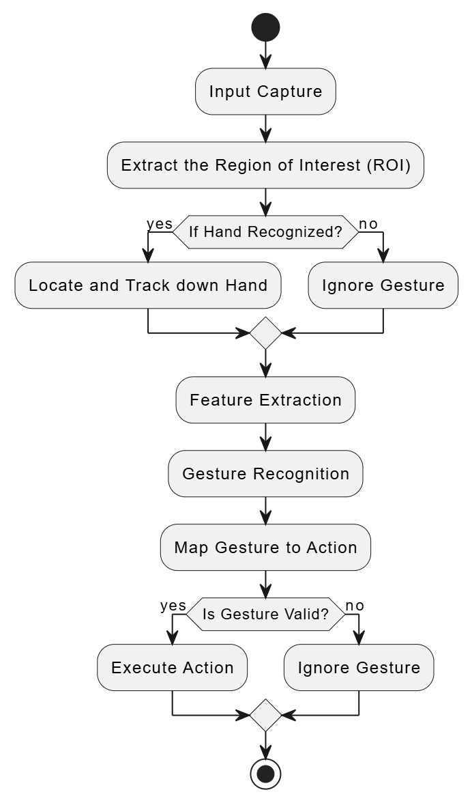
Flowchart Diagram
START
END

Slide 19
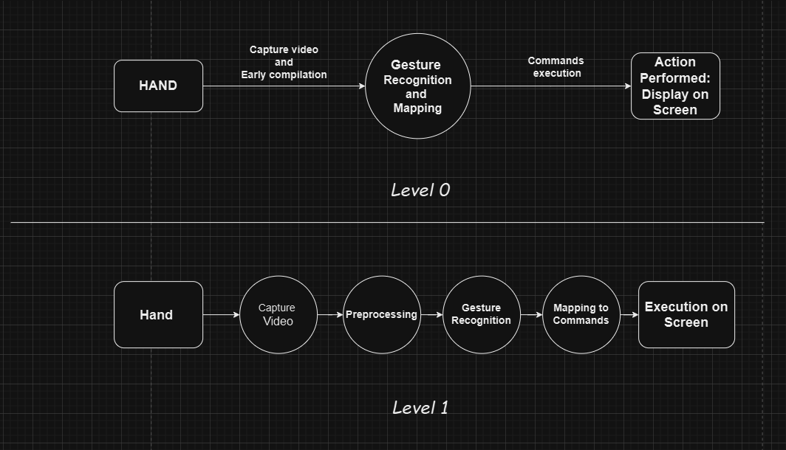
Data Flow Diagram

Slide 20
Hardware Requirements
Hardware requirements :
Processor Needed: Intel Core i3 or above
RAM: 8GB or more for handling real-time processing and multitasking between object detection and gesture control.
Webcam: 720p HD Webcam for basic hand gesture recognition
Screen Resolution: 1920 x 1080 (Full HD) resolution for better display of real-time streams and user interfaces.
GPU: A powerful GPU like NVIDIA GTX 1080 or RTX 3090 for real-time detection and gesture tracking.
Cameras: High-definition cameras (1080p or 4K) to capture detailed footage for better gesture recognition and precise object detection

Slide 21
Software Requirements
Software requirements
Operating System: Windows or Linux
YOLOv8 : Pre-trained YOLO (You Only Look Once) model for real-time hand gesture detection.
Programming Language : Python and Packages in Python (OpenCV, Mediapipe)
Development Tool : IDE( PyCharm or Visual Studio Code)
Deep Learning Frameworks : PyTorch or TensorFlow
Webcam Interface: For real-time streaming and video input from the webcam for gesture recognition and object detection.
Voice Assistant Integration : Speech Recognition and Python libraries for voice input and output functionalities.

Slide 22
Classification Model
Deep Learning
Deep Learning is a subset of machine learning. It is basically learning and improving on its own by examining other algorithm.
It works on artificial neural network that was designed to imitate human think and learn capabilities.
Mediapipe
MediaPipe to recognize the hand and the hand key points.
MediaPipe returns a total of 21 key points for each detected hand.

Slide 23
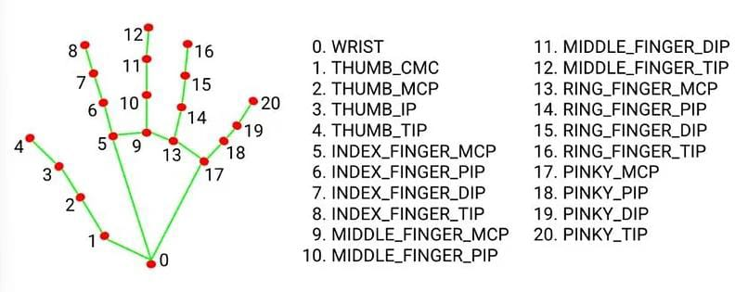

Slide 24
Technical Details
1. Initialize Libraries:
Import necessary libraries: OpenCV, MediaPipe.
Initialize the webcam for video capture using OpenCV.
Load the MediaPipe hand tracking model.
2. Capture Video Input:
Start the webcam feed.
Continuously read video frames from the webcam.
3. Convert Image for Processing:
Convert each captured frame from BGR (OpenCV default) to RGB format (required by MediaPipe).

Slide 25
4. Apply Hand Detection (Using MediaPipe):
Use MediaPipe’s hand detection model to detect hands in the current frame.
If a hand is detected, extract the 21 key hand landmarks (joints).
5. Process Landmarks:
Normalize hand landmark coordinates based on the size of the frame.
Calculate relative distances between key landmarks (e.g., distance between thumb tip and index finger tip).
6. Classify Gesture:
Compare the detected hand landmarks with predefined gestures using conditions or a machine learning model (e.g., open hand, closed fist, pinch).
Optionally, use angles between finger joints to improve classification accuracy.

Slide 26
Example: If the distance between the thumb and index finger tip is small, classify it as a "pinch".
Example: If all finger tips are spread apart, classify it as an "open hand".
7. Apply Gesture Recognition Logic:
Store recognized gestures in a variable for further processing or use.
Implement logic to handle continuous gesture recognition, including handling fluctuations between frames.
8. Display the Results
Draw hand landmarks and the gesture label (e.g., "open hand") on the video frame using OpenCV.
Show the video with landmarks and labels in real-time.

Slide 27
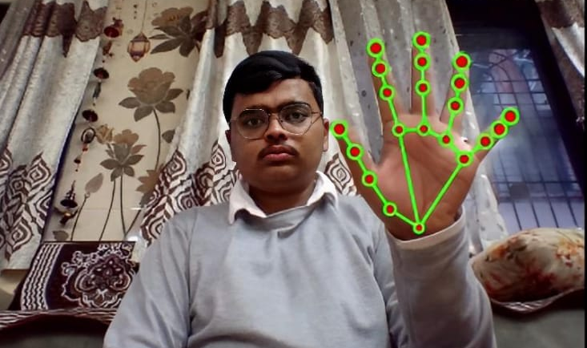
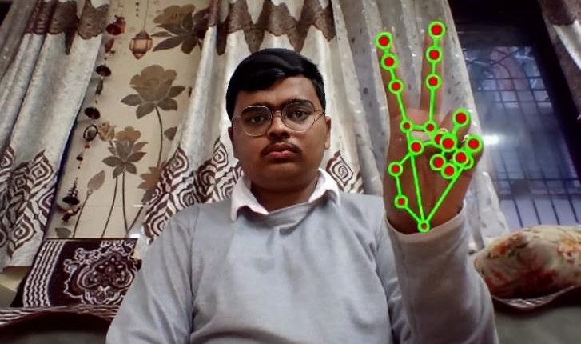
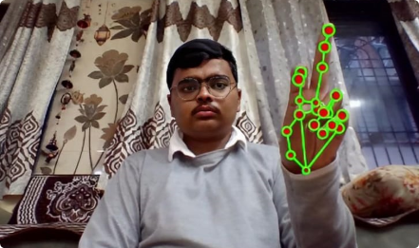
HAND GESTURES
NEUTRAL GESTURE
DYNAMIC GESTURE
LEFT CLICK GESTURE
Used to halt/stop the execution of the current gesture.
Used for the movement of the mouse.
Used to implement the use of the left mouse button.

Slide 28
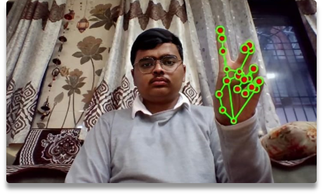
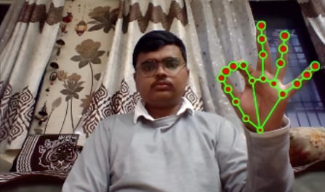
RIGHT CLICK GESTURE
Increasing and Decreasing Gesture
Used to implement the use of the right mouse button.
Used for increasing and decrease the volume, brightness and more on the screen.

Slide 29
Voice Assistant Features
Launch / Stop Gesture Recognition : Enable or disable gesture-based controls.
Google Search : Perform web searches using Google.
File Navigation : Access and manage files.
Find a Location on Google Maps : Search for and view locations on Google Maps.
Current Date and Time : Retrieve the current date and time.
Copy and Paste : Manage text copying and pasting functions.
Sleep/Wake Up Voice Assistant : Put the voice assistant to sleep or wake it up.

Slide 30
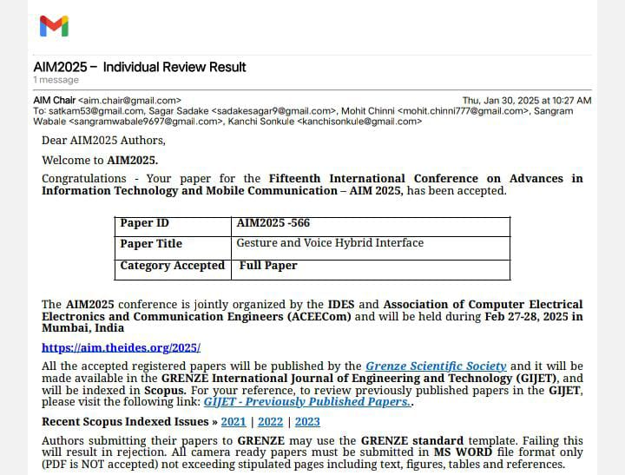
Fifteenth International Conference on Advances in Information Technology and Mobile Communication AIM 2025

Slide 31
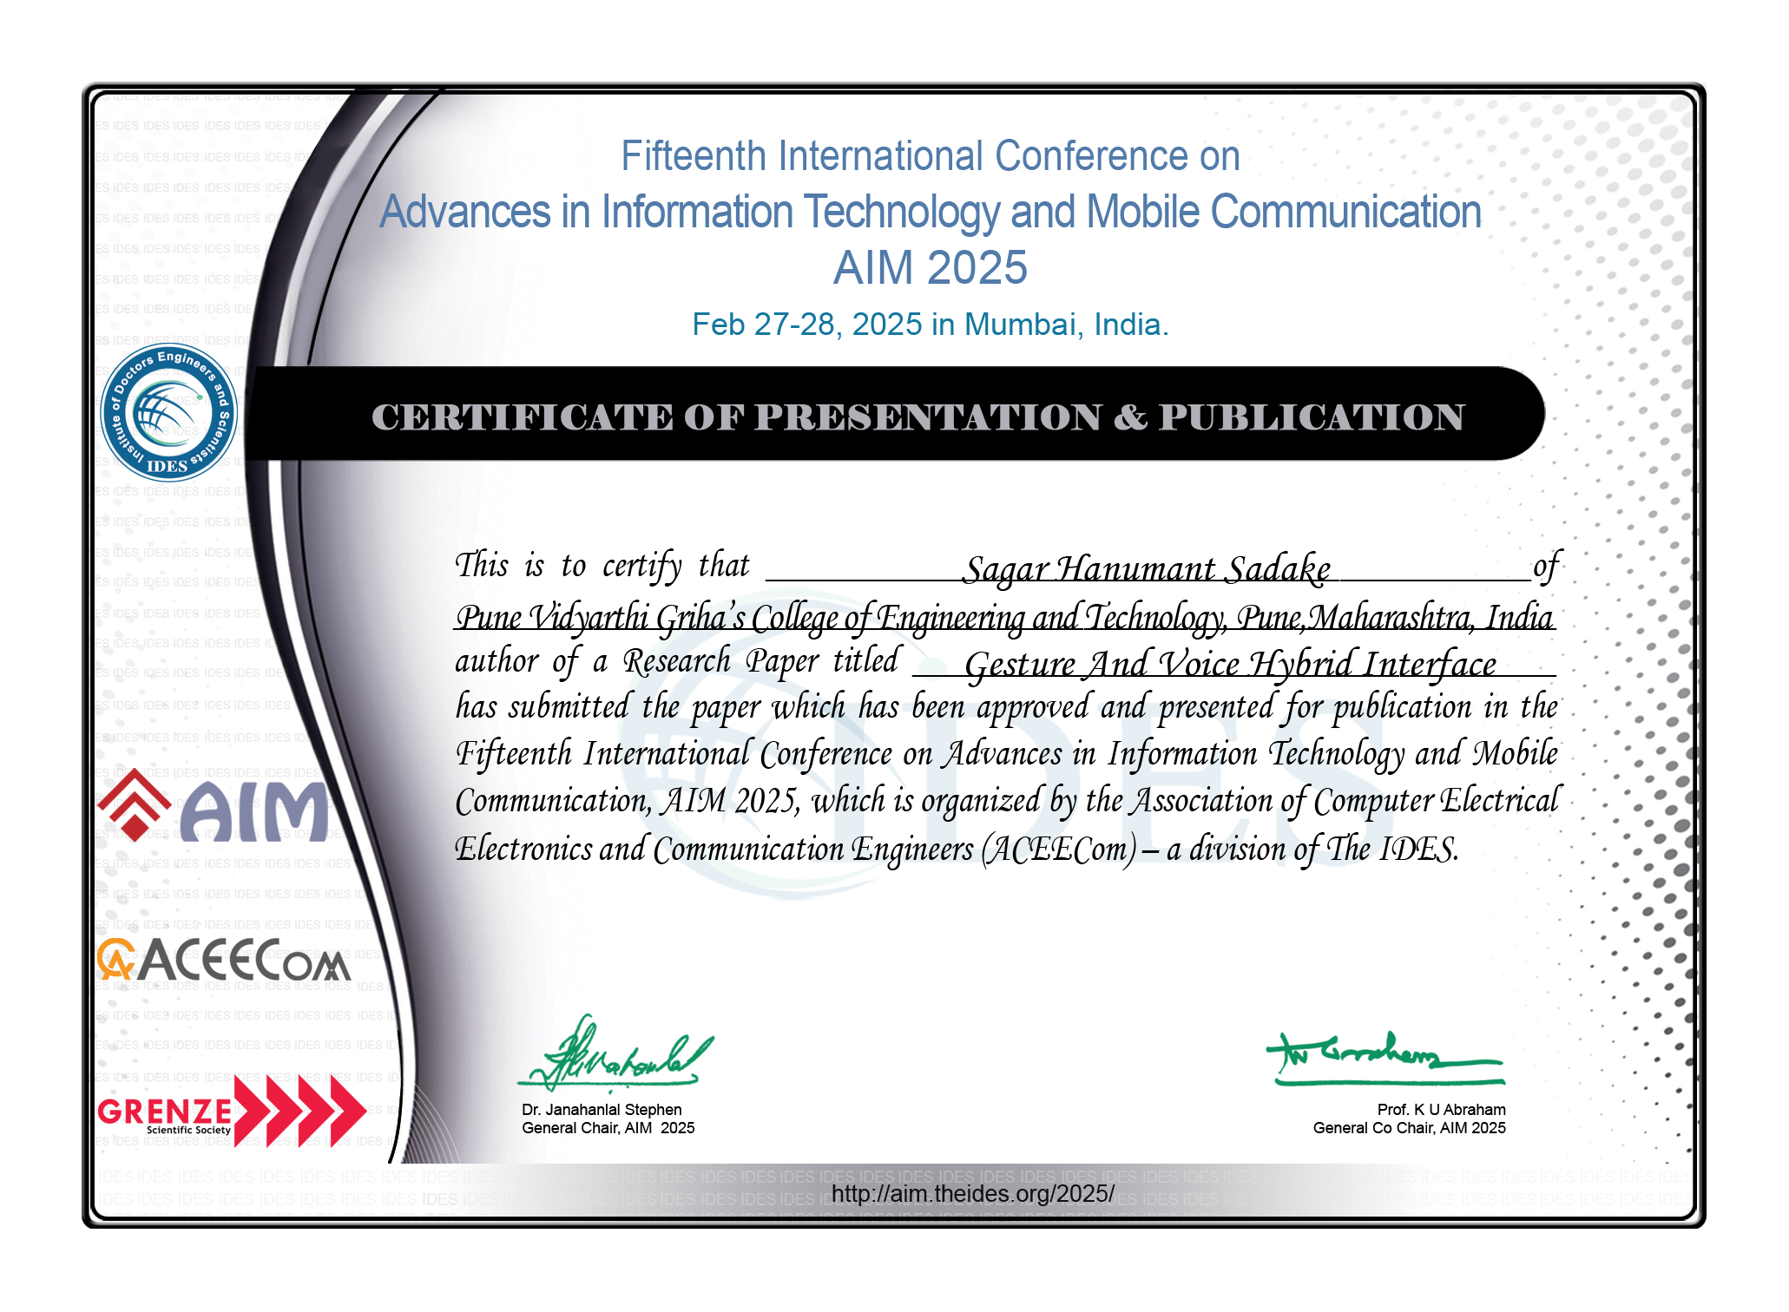
Certificate

Slide 32
Result Analysis
The Gesture Voice Hybrid Interface was tested across multiple user interactions to evaluate its performance in terms of accuracy, responsiveness, and user satisfaction.
Feature | Accuracy | Average Response Time | User Feedback
Cursor Movement via Gesture | 92% | 0.3s | Smooth and intuitive
Click/Scroll Actions | 87% | 0.4s | Sometimes misinterprets gesture
Voice Commands (English) | 95% | 0.5s | Very responsive
Hybrid Mode (Gesture + Voice) | 90% | 0.6s | Seamless integration, futuristic feel

Slide 33
Project Cost
Component | Description | Estimated Cost (INR)
Laptop/PC | Already available for development | —
Webcam | Built-in or external | 2,000
Microphone | For capturing voice commands | 1,000
Paper Publication | Fifteenth International Conference on Advances in Information Technology and Mobile Communication AIM 2025 | 9,500
Internet | During development (3 months) | 1,000
Miscellaneous | Printing, reports, testing utilities | 500
Total Estimated Cost : 14,000 INR

Slide 34
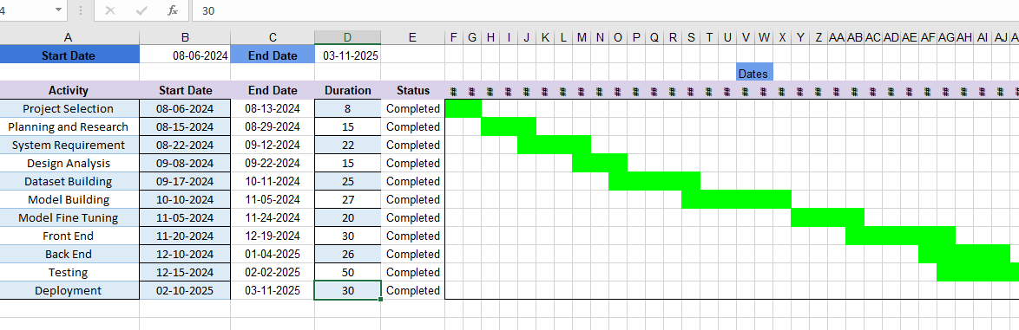
Project Plan

Slide 35
Advantages
Improved Accessibility : Makes technology usable for individuals with disabilities.
Enhanced User Experience : Provides a more natural and engaging interaction with devices.
Convenience : Allows for hands-free control, freeing users to perform other tasks simultaneously.
Increased Efficiency : Speeds up interactions and commands, reducing the need for traditional input devices.
Innovation : Drives development of new applications and tools that leverage gesture and voice inputs.

Slide 36
Conclusion
The "Gesture-Voice Hybrid Interface" project will showcase the potential to replace traditional input methods with hand gestures and voice commands.
This innovative approach is expected to bring several key benefits, such as enhanced accessibility by eliminating the need for physical devices like keyboards and mice, making digital systems more accessible to users.
The ability to control systems more naturally and efficiently is anticipated to boost productivity, reducing the time spent on manual input.
As this technology continues to evolve and undergo refinement, it holds the promise of transforming digital interaction by offering a more intuitive, natural, and inclusive user experience across a broad range of applications.

Slide 37
Future Scope
AI-Driven Personalization: Use machine learning to improve gesture accuracy, customize commands, and adapt to individual user patterns.
AR/VR and IoT Integration: Expand to AR/VR applications and smart home control for immersive, hands-free interactions.
Assistive Technology: Enhance accessibility for individuals with disabilities, enabling seamless computer control via gestures and voice.
Enhanced Voice Command Processing: Integrate advanced natural language processing (NLP) to interpret complex, multi-step voice commands, making the system more conversational and adaptable to various tasks.

Slide 38
References
Anuj Kumar; Anishkha Chaudhary; Anjani Singhal; Abhinav Dev; Arpit Jaiswal;” Gesture and Voice Controlled Virtual Mouse: A Review” Publisher: IEEE (Institute of Electrical and Electronics Engineers) April 2024
M. Nazeer, S. A. G, A. Priyadarshini, C. C. B. Krishna, A. Anusha and A. Amreen, "Gesture Controlled Virtual Mouse and Keyboard Using OpenCV" 2023, International Conference on Emerging Techniques in Computational Intelligence (ICETCI), Hyderabad, India, 2023
C Saritha,Y Phanitha,A Ramya Krishna, “Virtual Mouse Operations Using Webcam” ,June 2023 International Journal of Scientific Research in Science Engineering and Technology
S. Patil, S. Kanganolli, J. Deore, and K. Vartak, "Review on Touchless Virtual Mouse Technologies and A.I. Voice Assistants," International Journal of Progressive Research in Engineering and Management Science (IJPREMS), vol. 3, no. 3, pp. 160-167, 2023.
A. Mujahid, M.J. Awan, A. Yasin, M.A. Mohammed, R. Damasevicius, R. Maskeliunas, et al., "Real-Time HandGesture Recognition Based on DeepLearning ", Appl. Sci, pp. 11 4164, 2021.Available “https://www.mdpi.com/2076-3417/11/9/4164

Slide 39

Thank You …

